Slide 1
SOC beta phase report
January 17, 2018 – June 30, 2018

Slide 2
Executive Summary
We have reached or even exceeded our numerical targets – Hurrah!
File sharing system in line with curriculum structure is top priority for next few weeks
Harvesting potential synergies between GI general activities and GI – SOC activities required, e.g. promotion of events on SOC app and GI website must be synchronized and should be in the responsibility of one person
SOC content development lead handed over from Knut to Robyn
Robyn will step in to chair the curriculum development board
Knut will focus on workshop development and continues to oversee the technical development; requirement to clarify cooperation form

Slide 3
SOC Beta Phase Targets, Jan 17
5 communities
5 content partner
1000 users
10000 credits
Path to Success:
Balance content partners and users

Slide 4
Beta Phase Results, June 30
29 communities in SH & BJ
6 content partner
946 users
9744 credits
Path to Success:
Balance content partners and users
Notes:
Urban Rural Bridge
The Andean Apothecary
Zero Waste Shanghai
Green Steps
Green Initivatives
Telos Pi

Slide 5
Timeline, Milestones and Objectives
01/18
03/18
Beta phase
Proof of concept report
Full release
Gamma phase testing in GI team
Partnership & community building
Testing in selected communities and bug fixing
Offer to defined customer segments
Continuous development in non-profit communities
SOC App Launch
09/18
07/18
scalable, purposeful and enjoyable product
Ongoing: Chinese language content development

Slide 6
4 Key Ingredients for Success
Innovation
Technology
Timing
Appeal
Vision
Notes:
Timing:
Ecological tipping point
Vision:
Humanity in balance with nature on Earth – stop & reverse climate change
Technology:
Social media app
Appeal:
???
Gamificaiton
Avatars for reaching credit levels
Credit hongbao for inviting new users
Logos for learning types

Slide 7
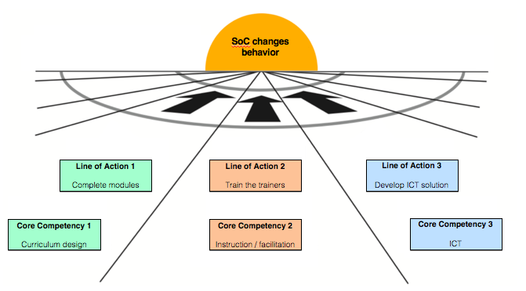
SOC Vision 2018
Line of Action 1
Develop Content Partners
Line of Action 2
Develop Communities
Notes:
Common vision (image of where we want to go)
Humanity in balance with nature on planet Earth
Mission (how we want to make the vision happen)
Collect and share solutions for sustainable models of growth and consumption
Assign LOAs / tasks to individuals and assign respective roles
Manage LOA and deadlines – how and who?
Communication of concept when joining team
Monthly SoC team meeting

Slide 8
LOA 1 - Curriculum Design / Content Partner
Existing partner
Urban Rural Bridge
The Andean Apothecary
Zero Waste Shanghai
Green Steps
Green Initiatives
Telos Pi
TODOS:
Maintain partner relationship
Add new partners in accordance with module structure
Train on file sharing system and SOC app

Slide 9
LOA 2 – Instruction&Facilitation / Community Development
This LOA requires a redefinition.
GI’s activities in regard to community development need to focus on corporate clients
Non corporate communities need to mushroom without further effort
The original idea that additional facilitators emerge from communities is still correct, but requires broad but clear guidelines similar to TED & TEDx

Slide 10
LOA 3 – ICT / App Development
Credit system on app works without major complications
Visual appeal needs to be improved
Avatars / gamification required to attract young and Chinese learners – would be great to have such a concept ready over summer
Payment system as value proposition for content partner is put on hold
File sharing system for content partners and facilitators is currently top priority to enable a structured growth of curriculum
GI website requires a SOC forum section which should be moderated by the respective module design team which is also in charge of the file sharing system

