Slide 1
Problem & Opportunity

Slide 2
“The most important question facing humanity is this: Can we reach global empathy in time to avoid the collapse of civilization and save the Earth?” ―
Jeremy Rifkin, Economist and political advisor
“We are currently facing the two biggest crisis in the history of our planet: the crisis of human resources, and the crisis of natural resources. Both crisis are just as severe, have the same origin and need to be addressed with the same seriousness.” ―
Sir Ken Robinson, Creativity and innovation expert
Need to get the right quotes in here
Notes:
“Human resources are like natural resources; they're often buried deep. You have to go looking for them, they're not just lying around on the surface. You have to create the circumstances where they show themselves. I believe our only hope for the future is to adopt a new conception of human ecology, one in which we start to reconstitute our concept of the richness in human capacity.”
https://www.trendhunter.com/keynote/redefining-education-speech

Slide 3
Problem
Notes:
http://www.thehrobserver.com/the-two-sides-of-the-employee-engagement-crisis/
https://ithinkbigger.com/solving-employee-engagement-crisis/
https://hbr.org/2016/08/the-dark-side-of-high-employee-engagement
https://www.forbes.com/sites/carminegallo/2011/11/11/your-emotionally-disconnected-employees/#21854cbe42d5
http://news.gallup.com/poll/188144/employee-engagement-stagnant-2015.aspx

Slide 5
A company is a teaching and learning institution. [Peter F. Drucker]

Slide 6
Solution
Notes:
https://www.decision-wise.com/employee-empowerment-vs-employee-engagement/

Slide 7
SOC – The Solution to the CSR Dilemma
Corporations are faced with HR scarcity: its both difficult to recruit and retain valuable staff.
Recruitment and training are huge hidden costs.
Corporations are supposed to engage in CSR but perceive it rather in terms of marketing and greenwashing.
Sincere CSR projects can help substantially to create a lasting attachment to an organization and retain employees.
SOC is an idea with social value creating a win-win (corporation-society) case.
CSR usually struggles to bring customers and revenue streams into focus, because they fall apart.
SOC solves this problem: customer and revenue stream are merged.
CSR is established in regard to employees and environment.
Notes:
It is often forgotten, that a corporation has most responsibility for its own employees.
CSR directed to external organizations fails to hit the sweet spot.
It is through a training of more empathy towards the environments that employees are supported in their personal development.

Slide 8
Social vs. Ecological Responsibility
S
Seeds of Change
Learning What Matters For More Empathy Towards The Environment

Slide 9
Nudging towards behavior change.
Awareness
意识
Understanding
理解
Action
行动
Film
Forum
Workshop
Fieldtrip
Campaign

Slide 10
Module Structure
Workshop (2)
Field trip (6)
Action campaign (4)
Film (2)
Engage in interactive understanding of relevant issues
Hands on and in-depth knowledge through site visits
Watch powerful documentaries and discuss local and global issues
Make things happen in your community

Slide 11
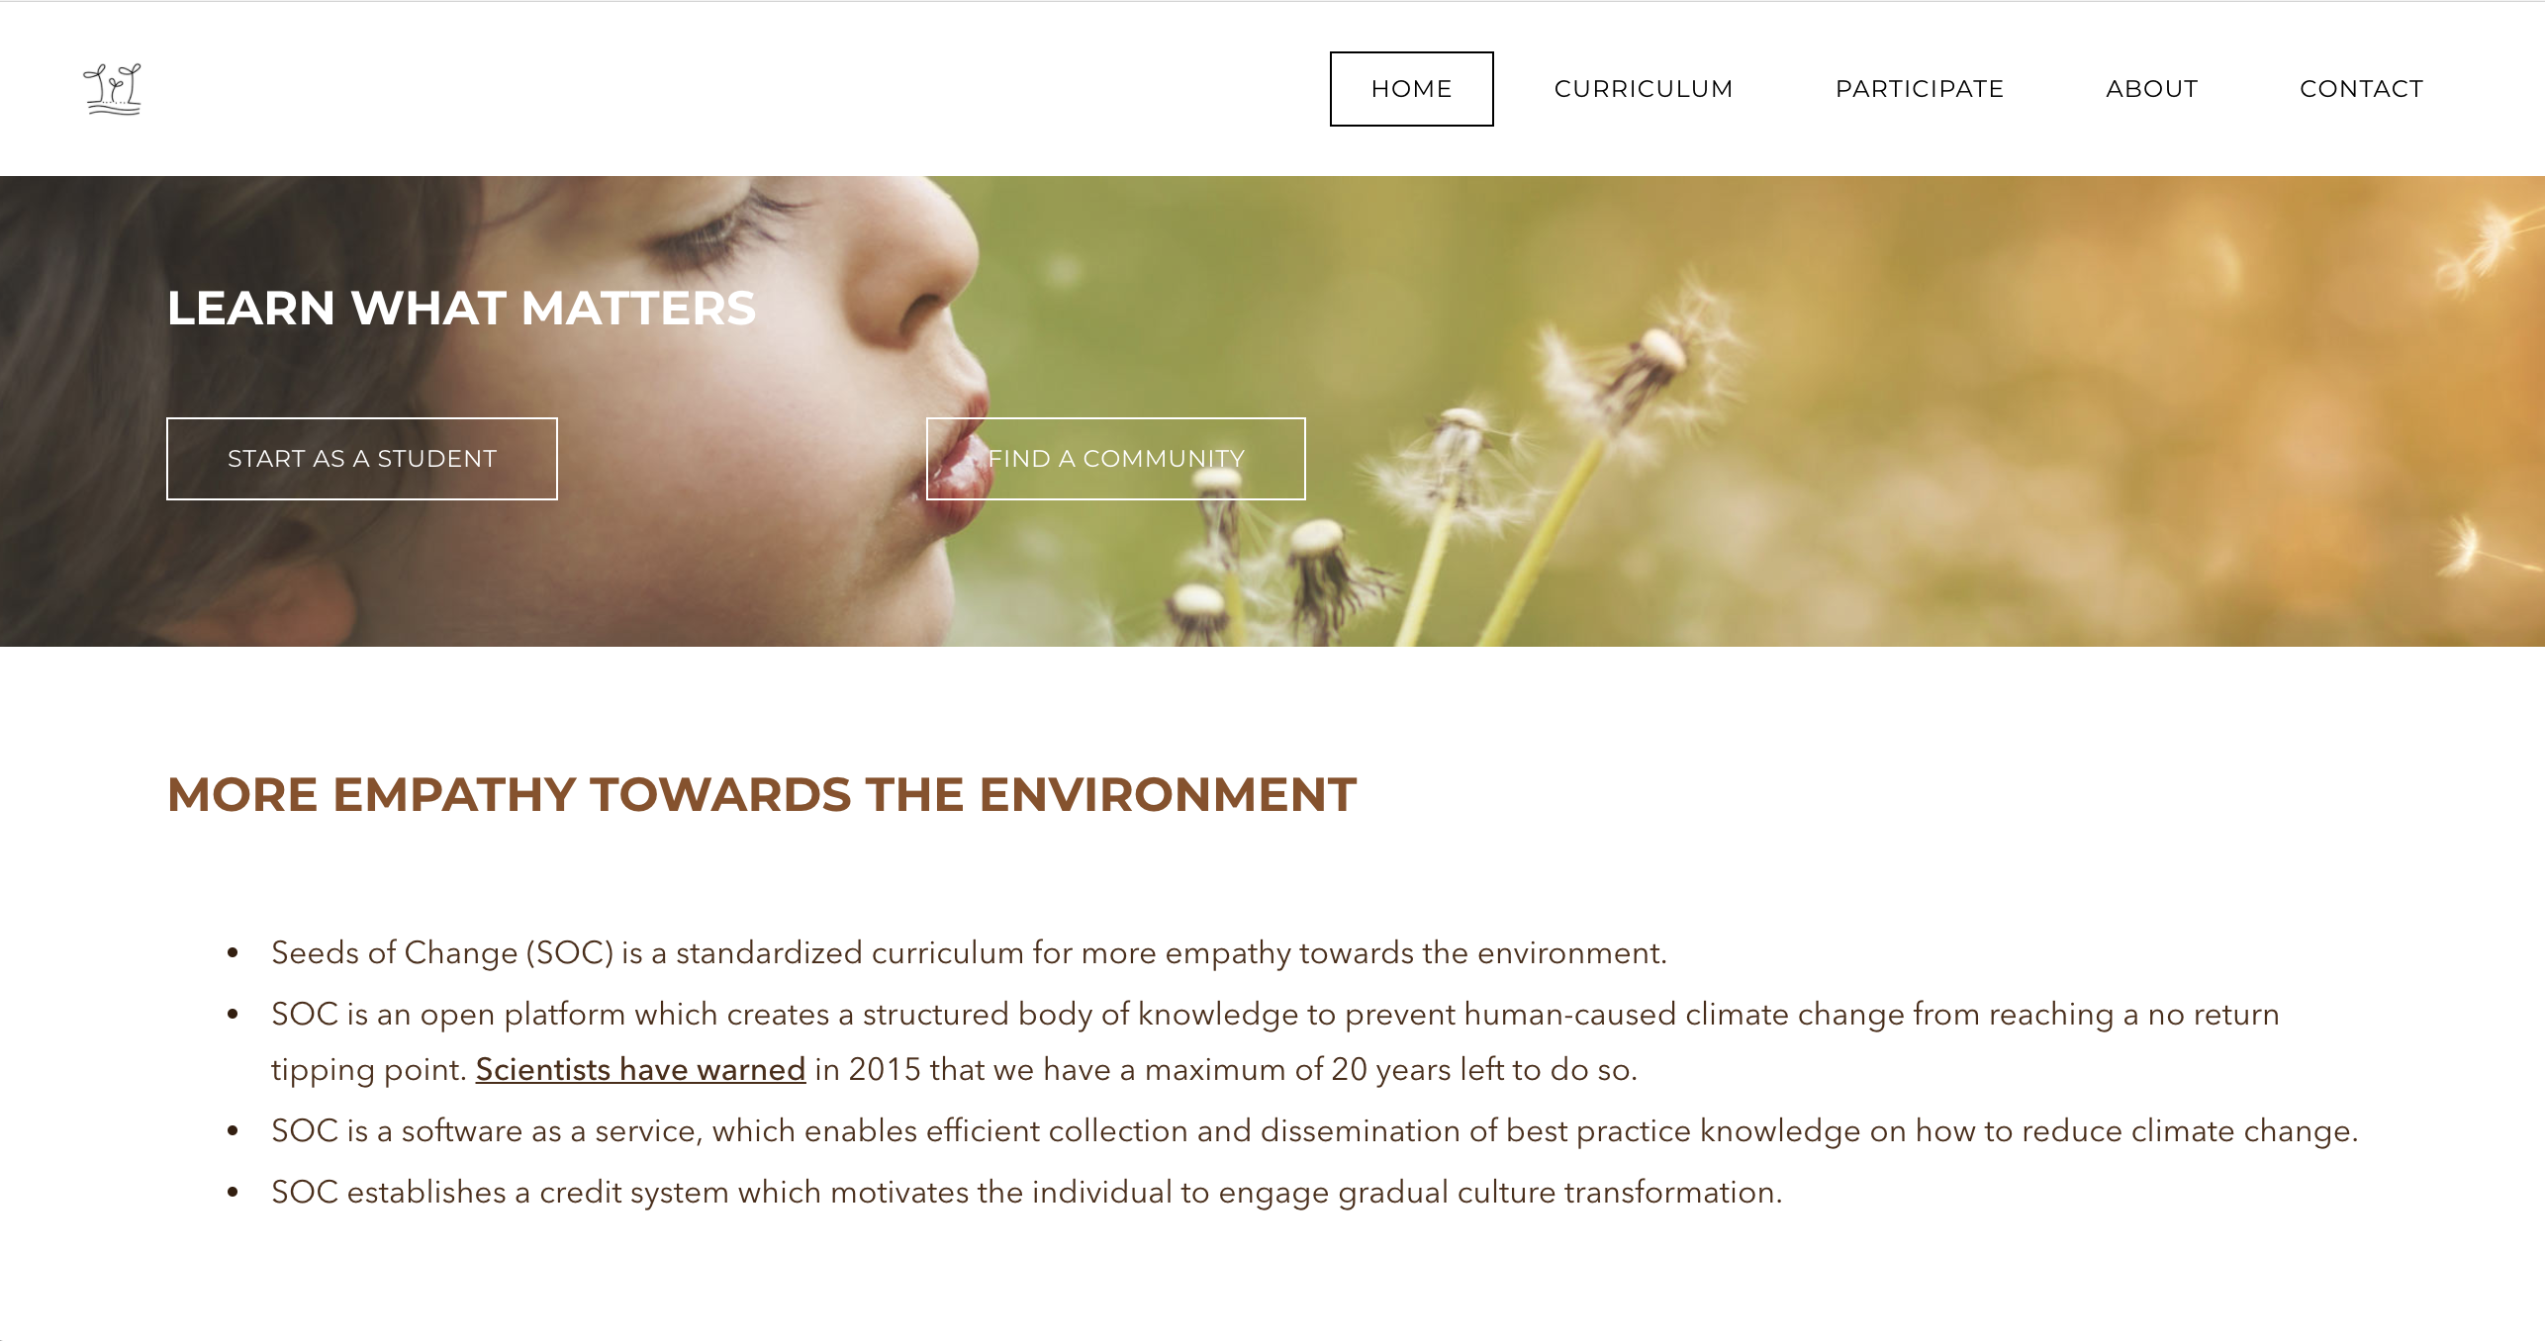
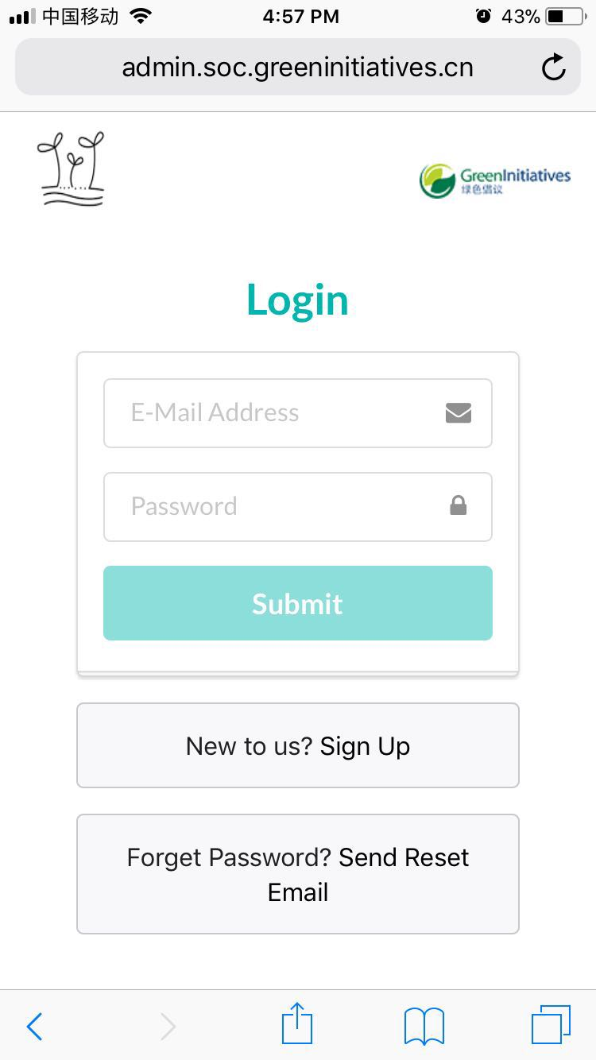
Concept概念
Collaborative learning > Community based and no virtual implementation
合作性学习>以社群为基础，无虚拟实行
Continuous learning > standardized expandable curriculum with individual target setting
持续性学习>含有个人目标设定的标准化可拓展式课程
Technology supported > online credit system which shows individual progress
技术支持>网上学分系统展现个人进展
www.seedsofchange.me
http://soc.admin.greeninitiatives.cn/ (beta)

Slide 12
SOC is based on the learning target concept of PADI: Professional Association of Diving Instructors
Notes:
Professional Association of Diving Instructors (PADI) is the world's largest^{[2]} recreational diving membership and diver training organization founded in 1966
PADI courses range from minimal entry level to relatively advanced recreational diver certification, several specialized diving skills courses
136k individual members and 6200 centers and resport
PADI's sister company Emergency First Response Corp provides a range of first aid and CPR programs for lay people
In March 2017 it was announced that PADI was sold by Providence Equity Partners LLC for US$700 million.[

Slide 13
SOC: The Way the World Learns to Survive 变革之源：世界学习生存的方式
Climate Change
Diet & Health
Food Production
Consumption & Waste
Energy & Mobility
Textiles
Standardized curriculum design 标准化课程设计
Decentralized module organization 分散板块组织
Open platform for best practice 提供最佳实践的开放式平台
Overview Effect
Work & Vocation
Power & Money
Cities & Urbanization
Learning & Knowledge
Body & Mind

Slide 14
How does SOC work?
Provide corporate, civil and school communities a standardized framework of ecological knowledge, which is valid beyond cultural boundaries
Facilitate enjoyable learning experiences which create community bonding and mission alignment to retain members
Give individuals clear learning objectives, which motivate to learn continuously
Emphasize collaborative and transgenerational learning in community
Collect best practice and share efficiently to trigger action

Slide 15
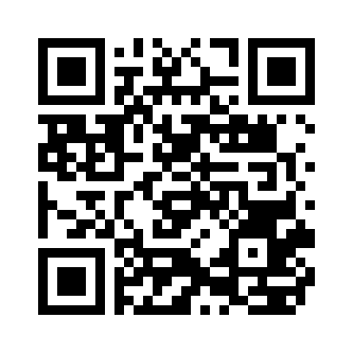
Contact
Seeds@greeninitiatives.cn
www.seedsofchange.me

