Slide 1
GI 2020 Business Strategy
Executive Summary

Slide 2
Existing GI Products - Summary
Existing products are purposeful,
a great channel to build brand awareness and
Create business traction, but
low margins and
increasing competition
Make it difficult to scale up operations and
Generate enough profit to employ full time staff

Slide 3
What is the Problem in Society?
We have most likely by 2015 passed a point of no return: environmental degradation threatens the survival of our species without massive changes in how we understand and act in regard to consumption and economic growth
Industrial education is geared towards academic excellence, covers only partially what really matters and does not equip us with the tools necessary to tackle the challenges ahead
Children as well as adults don’t know what to do with information thrown at them in books, internet and lectures which is devoid of knowledge or wisdom; a digital deluge obscures our vision from goodness, beauty and truth
Humans learn through mentoring, guidance, collaboration and play, but our societies slip into digital dementia; the youth is glued to smart phones, video games and augmented reality while the elders suffer from loneliness
Ancient lore is the integral understanding of and ultimately surviving in an ecosystem; it was handed down from the elders to the next generation
As the world industrializes we have lost our local ecosystems and deal with a global ecosystem; nobody really knows anymore how to act properly
What would be required from every individual to understand the global ecosystem and act sustainably cant be realistically demanded – collaboration and integral education is the only way forward
Notes:
Sources:
Climate researcher Alice Bows-Larkin: https://www.ted.com/talks/alice_bows_larkin_we_re_too_late_to_prevent_climate_change_here_s_how_we_adapt
Educator Ken Robinson:
Educator Neil Postman: Amusing Ourselves to Death; Huxley: Animal Farm; Data analyst Susan Etlinger: http://www.ted.com/talks/susan_etlinger_what_do_we_do_with_all_this_big_data
Robert Bly: Iron John; Johan Huizinga: Homo Ludens; teacher John Hunter: http://www.ted.com/talks/john_hunter_on_the_world_peace_game
Daniel Goleman: Focus – The Driver of Excellence
Daniel Goleman: Focus – The Driver of Excellence
Integral education is trans-generational and analogue as opposed to industrial education which separates humans according to DOM

Slide 4
What is the Solution?
Design an framework of external and internal competencies which is valid beyond cultural boundaries
Provide employers and educational bodies a clear range of coursework to choose from
Give individuals a clear continuous learning framework which motivates to qualify ever more
Use psychological needs to attract users
Be able to ask for higher pricing and earn a higher margin with corporate clients
Apply ICT to standardize and scale up, but
Continue to focus on communities and personal change as main vehicle for implementation
Change starts with myself.

Slide 5
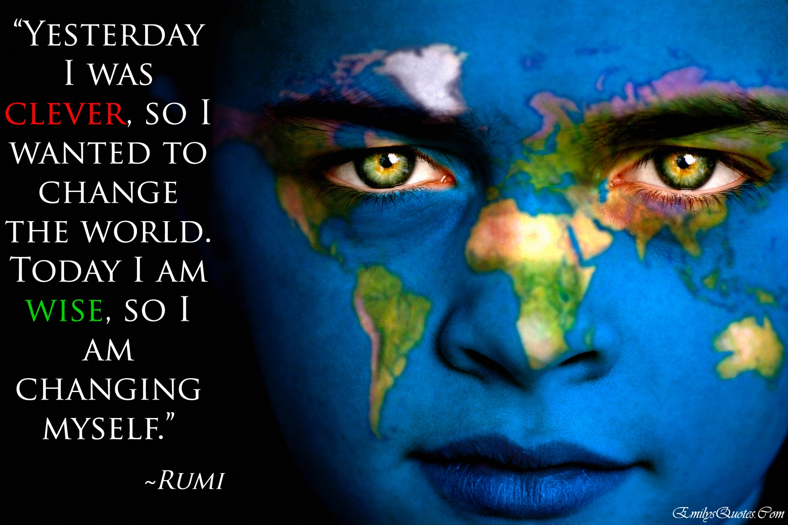

Slide 6
What is the Problem for Corporations?
Corporations are faced with HR scarcity: its both difficult to recruit and retain valuable staff.
Recruitment and training are huge hidden costs.
Corporations are supposed to engage in CSR but perceive it rather in terms of marketing themselves or get absolution for their unethical deeds.
The crucial question is how to align an idea with social value to one’s business to create a win-win (corporation-society) case.
CSR struggles to bring customers and revenue streams into focus, because they fall apart.
CSR must be central to the overall business strategy

Slide 7
Offering
Customers
Infrastructure
Notes:
Explain the CSR struggle with 2 examples:
Company Y runs autism support project (i.e. company Y offers an additional CSR product): value proposition is a first-stop support platform; customer segment are affected families; revenue stream comes almost entirely from service provider (= company Y), not from customer
Company X runs SoC curriculum: value proposition is employee retention AND benefits to society at large; customer

Slide 8
What is the Solution?
Sincere CSR can help substantially to create a lasting attachment to an organization and retain employees.
Corporations engaging in a continuous certification which activates learned sustainability knowledge, implements ISO 26000 and creates a win-win situation (assuming that their employees enjoy the process and stay with their employer).
Revenue streams do not anymore fall apart, but are suddenly where they are supposed to be: the corporation pays for a training and receives a service (= staff retention) which can be financially quantified (less recruitment and in house training) and serves society at large.
Corporations ideally tie their compensation system (so called soft KPIs) to the values which are being taught in the SoC curriculum
Notes:
If SoC is perceived as a product which the business provides to its internal customers = employees the same logic can be applied.
Employees pay with their time and loyalty; the business with its investment in SoC

Slide 9
BMC: Seeds of Change
Expert trainers (Zero Waste, DIY cosmetics, DIY detergents, etc.)
Waste management facilities (for visits)
Plastic bottles to textiles plant (for visit)
Etc.
Project launch
Workshop delivery
Site visits
Workshop development
Internal training
Etc.
Sales pitch
Project manager
Launch
Trainer-participant and trainer-HR communications
Corporations
Schools
Universities
Youth Programs/Camps
Conference Organizations
Explain and implement ISO 26000 & ISO 14000
Provide a CSR project which generates a genuine win-win situation
Provide a continuous learning framework which can be tied to “soft” KPIs
Option for HR departments to buy a dashboard to see learning progress (like Khan Academy)
Standard office O/H
Product developers*
Project manager
Trainers
CSR network events
WeChat
GI website/emails
Chambers of Comm.
Networking events
Partners
Participants

Slide 10
Strategy Process Summary
Social media
Certification APP
Current GI products
ISO 14000 (environment) & 26000 (CSR)
UN Sustainability Development Goals
Notes:
Identification of current products > realizing that they have built a strong brand and loyal followership, but are hard to scale up because of increasing competition; and because GI would have to deal despite low margins with all the hassle all other for profit companies have to deal with: customer acquisition, market segmentation > lots of pull power required
Certification of people instead of buildings has come up to lift GI into a metalevel were it can’t be touched by competition respectively can play the function of a hub which > the main obstacle is here that certifications and standards will easily get into conflict with governments, in particular in China, which has a monopoly thereon.
Sustainability facebook as final conclusion, because from economic, psychological, philosophical and neurological perspective it is what is needed now a what will most likely work > all information is pushed to GI; crowdsourcing
TBD: organize GI not like facebook, but like Wikipedia (explain encyclopedia Britannica case) and paramount: provide a platform from which others can navigate and where everybody can contribute – that is the success key of wikipedia, tencent, facebook, etc.

Slide 11
Next Steps
What has to be done next
to make this happen?
July 6

Slide 13
Next Steps
Continue curriculum development:
Take what is available and integrate into a modular curriculum
which consists always of 1 lecture, 1 film, 1 field trip, 1 campaign
External and internal curricula must be finished by end 2017 = complete one module/m
design a curriculum framework to corporate HR clients which can be tied to KPIs
Change starts with myself:
all GI team members must take all classes and are
guinea pigs for the curriculum development = train the trainers
offer the entire range, but only sell what is available
Move fast with what GI already has: Imbd, Goodreads, products, etc
Define legal and operational framework
APP / PLUGIN development
Brainstorm on technical environment for APP
Define project timeline and beta version launch date
Develop simple app and continuously extend functionalities
Talk to VC investors

Slide 14
SoC
Quick Guide
Notes:
This is a Section Header slide

Slide 15
Why do we need SoC?
In a system there are no side effects – just effects, anticipated or not. What we see as “side effects” simply reflects our flawed understanding of the system. In a complex system cause and effect may be more distant in time and space than we realize. > My behavior and your behavior makes a difference.
Community
Local Ecosystem
Ancient Lore
Society
Global Ecosystem
Seeds of Change
Notes:
TODO: would need a visualization here, which shows the transformation from hunter&gatherer communities to modern societies.
German sociologist Ferdinand Tönnies used the terms Gemeinschaft (community) and Gesellschaft (society) to refer to the distinction between societies organized on the basis of kinship and tradition, on the one hand, and by specialization and self-interest, on the other. As modern societies become more urban and industrial, the former is replaced by the latter.
Ancient lore is the integral understanding of and ultimately surviving in an ecosystem; it was handed down from the elders in hunter & gatherer communities to the next generation. As the world industrializes we have lost our local ecosystems and deal with a global ecosystem; nobody really knows anymore how to act properly. SoC tries to fill this gap by combining the instruction of a standardized science based curriculum in and for interest communities (Durkheim).
Excerpt from Focus – The Driver of Excellence: Chapter 13 – System Blindness [must read for presenter & instructor]
Such lore, handed down for generations from elders to the young, exemplifies the local knowledge that native peoples everywhere have relied on to survive in their particular ecological niche, letting them get basics like food, safety, clothing, and shelter.
Through human history, system awareness – detecting and mapping the patterns and order that lie hidden within the chaos of the natural world – has been propelled by this urgent survival imperative for native peoples to understand their local ecosystems. They must know what plants are toxic, which nourish or heal; where to get drinking water and where to gather herbs and find food; how to read the signs of seasonal change.
Here’s the catch. We are prepared by our biology to eat and sleep, mate and nurture, flight-or-flee, and exhibit all the other built-in survival responses in the human repertoire. But as we’ve seen, there are no neural systems dedicated to understanding the larger systems within which all this occurs.
Systems are, at first glance, invisible to our brain – we have no direct perception of any of the multitude of systems that dictate the realities of our lives. We understand them indirectly, through mental models (the meanings of wave swells, constellations, and the flight of seabirds are each such models) and take action based on those models. The more grounded in data those models are, the more effective our interventions (for example, a rocket to an asteroid). The less grounded in data, the less effective they will be (much education policy).
This lore stems from hard-learned lessons that become distributed knowledge, shared among a people, such as the healing property of specific herbs. And older generations pass on this accumulated lore to the younger. (GI app > green lore > must be transformed into a big data app). […] Much of the loss of native lore is due to acculturations and colonization, and governments marginalizing native wisdom.
The invention of culture was a huge innovation for homo sapiens: creating language and a shared cognitive web of understanding that transcends any individual’s knowledge and life span – and that can be drawn on as needed and passed on to new generations. Cultures divide up expertise: there are midwives and healers, warriors and builders, farmers and weavers. Each of these domains of expertise can be shared, and those who hold the deepest reservoir of understanding in each are the guides and teachers for others.
Native lore has been a crucial part of our social evolution, the way cultures pass down their wisdom though time. Primitive bands in early evolution would have thrived or died depending on their collective intelligence in reading the local ecosystem: to anticipate key moments for planting, harvesting, and the like – and so the first calendars came into being.
But modernity has provided machines to take the place of such lore – compasses, navigational guides, and, eventually, online maps – native people have joined everyone else in relying on them, forgetting their local lore, like wayfinding.
Ecological intelligence can vanish from collective memory within a generation as the forms for passing it on vanish. […] Lindsay – an anthropologist raised by native healers in Hawaii – told me, “I was taught by my elders that when you go into the forest to pick flowers for making leis or plants for medicine, you only take a few blossoms or leaves from each limb. When you’re done, the forest should look like you had never been there. Today kids often go in with plastic bags and break off branches.”
This obliviousness to the systems around us has long puzzled me, particularly as I’ve investigated our collective cluelessness in the face of a threat to our species survival posed by our daily doings. We seem curiously unable to perceive in a way that leads us to prevent the adverse consequences of human systems, such as those for industry and commerce.
Much of the time people attribute what happens to them to events close in time and space, when in reality it’s the result of the dynamics of the larger system within which they are embedded.
The problem gets compounded by what’s called the “illusion of explanatory depth”, where we feel confidence in our understanding of a complex system, but in reality have just superficial knowledge. Try to explain in depth how an electric grid operates or why increasing atmospheric carbon dioxide ups the energy in storms, and the illusory nature or our systems understanding becomes clearer.
In addition to mismatches of our mental models and the systems they presume to map, there are even more profound predicaments: our perceptual and emotional systems are all but blind to them. The human brain was molded by what helped us and our forerunners survive in the wild, particularly in the Pleistocene geological epoch (roughly from 2 million years ago to about 12k years ago, when there was the rise of agriculture).
We are finely tuned to a rustling in the leaves that may signal a stalking tiger. But we have no perceptual apparatus that can sense the thinning of the atmosphere’s ozone layer, nor the carcinogens in the particulates we breathe on a smoggy day. Both can eventually be fatal, but our brain has no direct radar for these threats.
Its not just perceptual mistuning. If our emotional circuitry (particularly the amygdala, the trigger point for the fight-or-flight response perceives an immediate threat it will flood us with hormones like cortisol and adrenaline, which ready us to hit or run. But this does not happen if we hear of potential dangers that might emerge in years or centuries to come; the amygdala hardly blinks.
The amygdala’s circuitry, concentrated in the middle of the brain, operates automatically, bottom-up. We rely on it to be on the alert for dangers and tell us what we need to pay urgent attention to. But our automatic circuitry, usually so reliable in guiding our attention, have no perceptual apparatus or emotional loading for systems and their dangers. They draw a blank.
“Its easier to override an automatic, bottom-up response with top down reasoning than it is to deal with the complete absence of a signal,” Columbia University psychologist Elke Weber observes. “But that’s the situation when it comes to dealing with the environment. There’s nothing here in the Hudson Valley on this lovely summer day to tell me the planet is warming.” […] But unless you live in the Maldives or Bangladesh, it seems far away. The dimension of time is a huge problem – if the pace of global warming were accelerated to a few years instead of over centuries, people would pay more attention. But it’s like the national debt: I’ll leave it to my grandchildren – I am sure they’ll think of some solution.
At one time, the survival of human groups depended on ecological attunement. Today we have the luxury of living well using artificial aids. Or seem to have the luxury. For the same attitudes that have made us reliant on technology have lulled us into indifference to the state of the natural world – at our peril. [> Belphegor] So to meet the challenges of impending (global) system collapse we need what amounts to a prosthesis of the mind. [> GI app]

Slide 16
What is the Solution?
Design an framework of external and internal competencies which is valid beyond cultural boundaries
Provide employers and educational bodies a clear range of coursework to choose from
Give individuals a clear continuous learning framework which motivates to qualify ever more
Use psychological needs to attract users
Be able to ask for higher pricing and earn a higher margin with corporate clients
Apply ICT to standardize and scale up, but
Continue to focus on communities and personal change as main vehicle for implementation
Change starts with myself.

Slide 17
How Could a Certification Process Look Like?
Green Academy: The Way the World Learns to Survive - Change starts with myself!
M1
Intro
M11
Cities
M2
Air
M10
CSR
M12 Sharing Economy
M3
Water
M9
Waste
M4 Food Production
M8
Transport
M5
Nutrition
M7
Energy
Register user
M6
Non-Food
Notes:
TODO: design a module overview for external presenation

Slide 19
How do we spread SoC?
How do things actually spread?
Through personal word of mouth interaction and outstanding virtual presentation
Community
Society
Personal & word of mouth
Virtual &
MOOC
Notes:
1. Through establishing GI communities all over the planet = personal, organizational and transgenerational
2. In society through an MOOC format like Khan Academy, EdX, etc.
Mention example of Microsoft Enyclopedia and Wikipedia – way forward it open source and FOC

Slide 20
Embedding SoC in Existing Systems
Social media
Standardized Curriculum
Current GI products
ISO 14000 (environment) & 26000 (CSR)
UN Sustainability Development Goals
Notes:
Identification of current products > realizing that they have built a strong brand and loyal followership, but are hard to scale up because of increasing competition; and because GI would have to deal despite low margins with all the hassle all other for profit companies have to deal with: customer acquisition, market segmentation > lots of pull power required
Certification of people instead of buildings has come up to lift GI into a metalevel were it can’t be touched by competition respectively can play the function of a hub which > the main obstacle is here that certifications and standards will easily get into conflict with governments, in particular in China, which has a monopoly thereon.
Sustainability facebook as final conclusion, because from economic, psychological, philosophical and neurological perspective it is what is needed now a what will most likely work > all information is pushed to GI; crowdsourcing
TBD: organize GI not like facebook, but like Wikipedia (explain encyclopedia Britannica case) and paramount: provide a platform from which others can navigate and where everybody can contribute – that is the success key of wikipedia, tencent, facebook, etc.

Slide 21
Customer Segmentation
Ideal customer:
Have a large population of students/employees/staff
Want to engage a large amount of people at once
Has a desire for awareness, engagement and change
A budget to pay for participation cost
Industry (Customer) | Target Contact Person
Corporations | Human Resources Marketing Director CSR Department
Schools/Universities | Dean, President, Chancellor ? Green Department, Sustainability Department
Youth Programs/Camps | Educators, Principals, Teachers
Conference Organizations (Business professional conferences, trade conferences, student conferences, etc.) | Organizers of various conferences

Slide 22
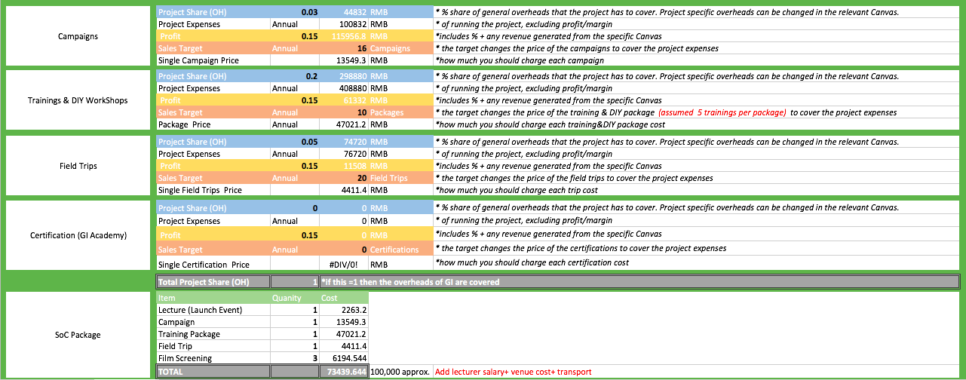
Product Package & Pricing
TBC
TBD

Slide 23
Timeline and Milestones
GI general = Nitin
BP clarified & office space
Dedicated accountant
TED conference
Vancouver
171130
170131
180410
SoC
= Knut
Finalize SoC curriculum V01
Implementation of SoC beta phase product
171215
180101
180630
ICT
= Florian
Meeting
ND, KW and FZ
Develop pilot product
Implementation of ICT beta phase product
170918
171015
171215
180101
180630
BP
= Chris
BP ready for VC

